Slide 1
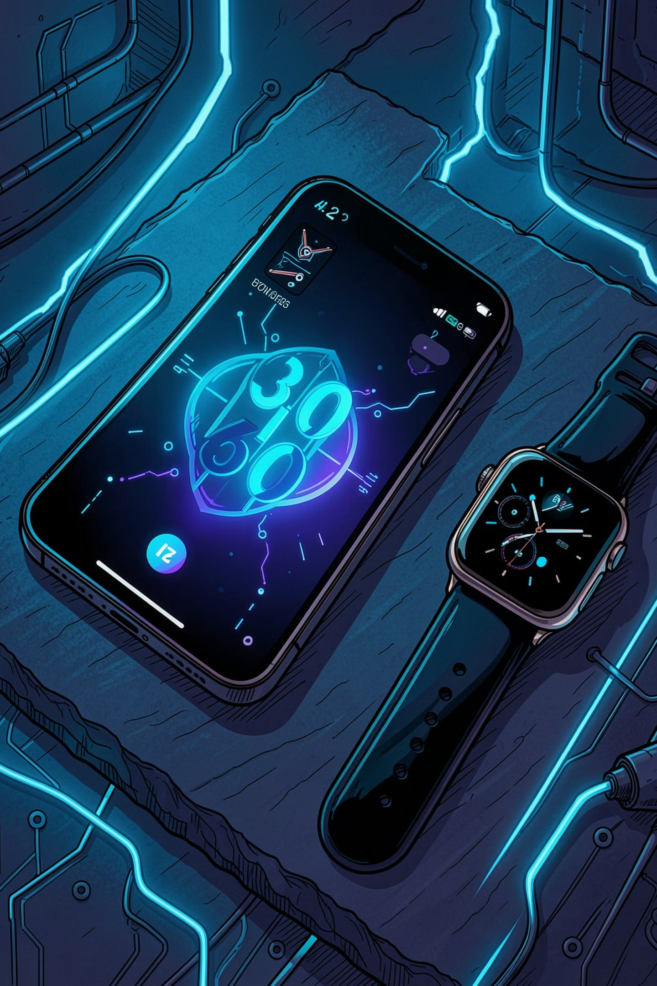
Hand-held and Wearable Devices: The Evolution of Personal Computing
Understanding the Architectures, Categories, and Interconnectivity of Next-Generation Form Factors
IT 30: Human Computer Interaction 2 (Module #2)

Slide 2
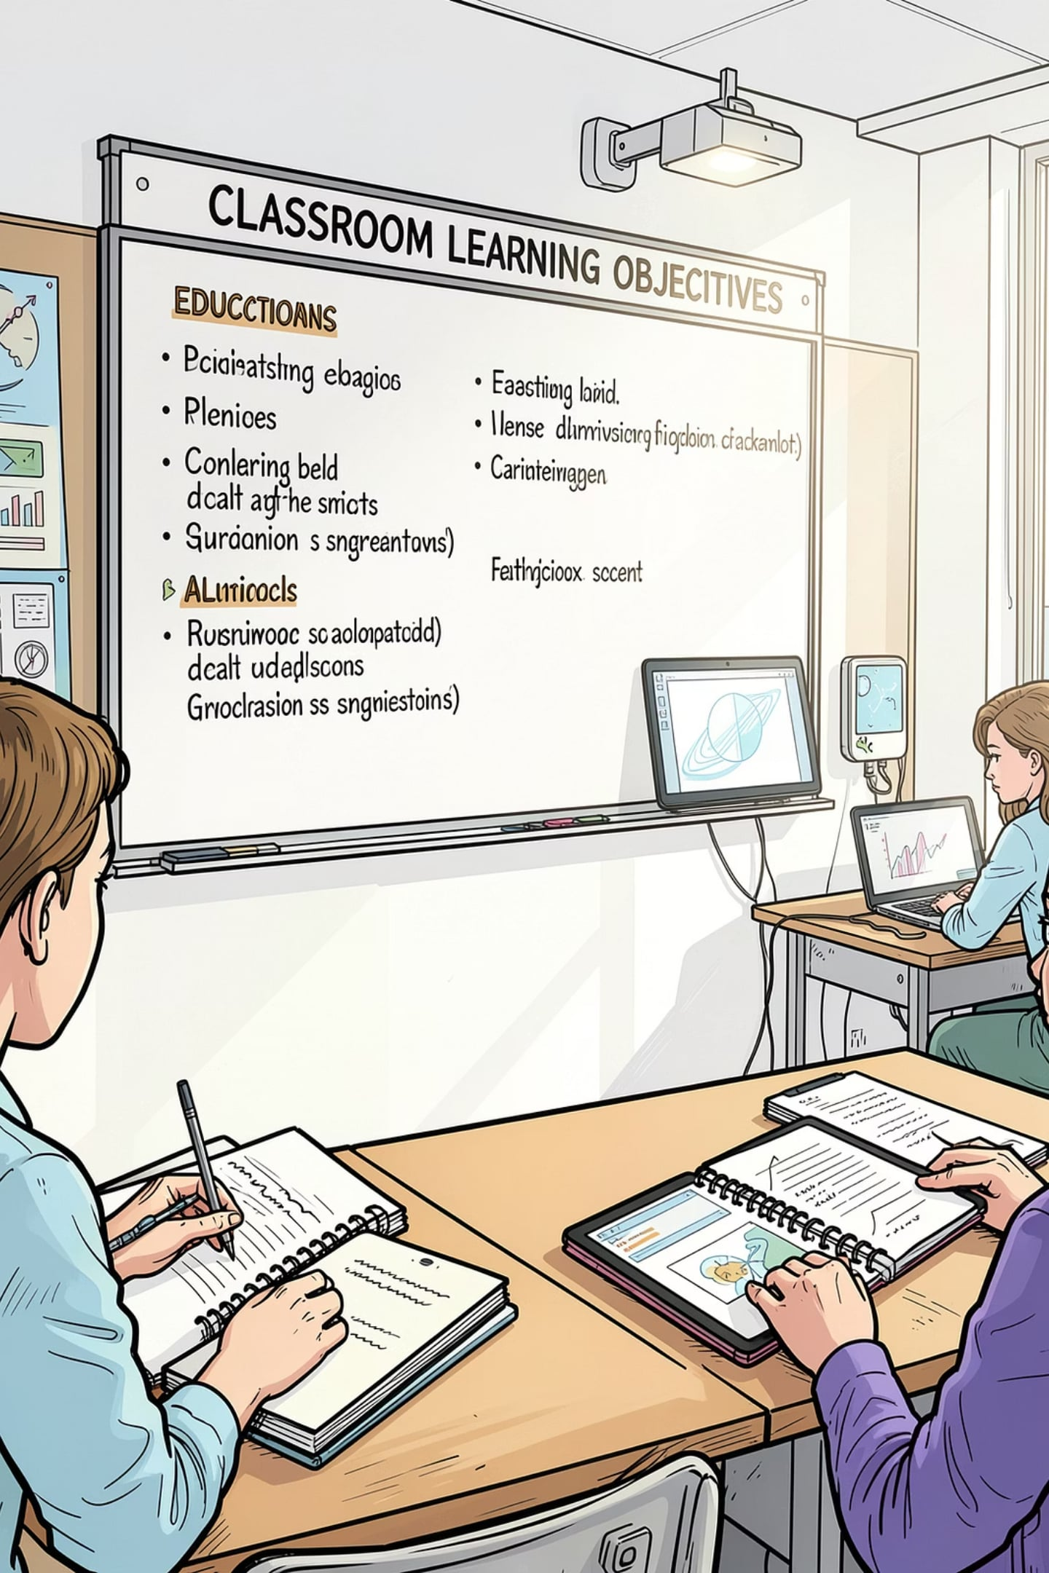
Core Learning Targets & Objectives
Primary Learning Targets
Define Intentional Handling: Establish clear, precise criteria for the proper physical handling, operational management, and lifecycle safety of hand-held and wearable infrastructure.
Taxonomical Classification: Analyze, differentiate, and categorize the multi-faceted ecosystems powering modern handheld systems and wearable biological devices.

Slide 3
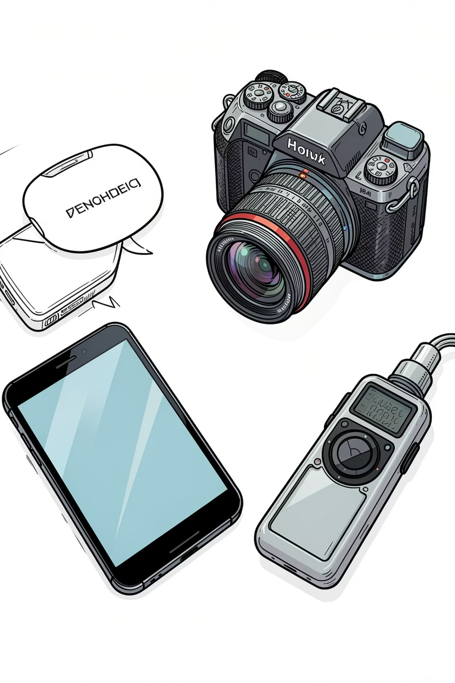
Introduction to Technological Devices
The Unified Definition
"A technological device encompasses any computing system, cellular phone, smartphone, digital camera, video camera, audio recording instrument, or specialized electronic architecture engineered to create, store, securely isolate, or transmit information in the form of electronic data."
Key Capabilities & Functional Core
Creation
Storage
Capturing raw real-world inputs (media, audio, biosignals) and converting them into structured digital metrics.
Locally retaining transactional, operational, and user telemetry data.
Transmission
Moving payloads seamlessly across distributed computing networks.

Slide 4
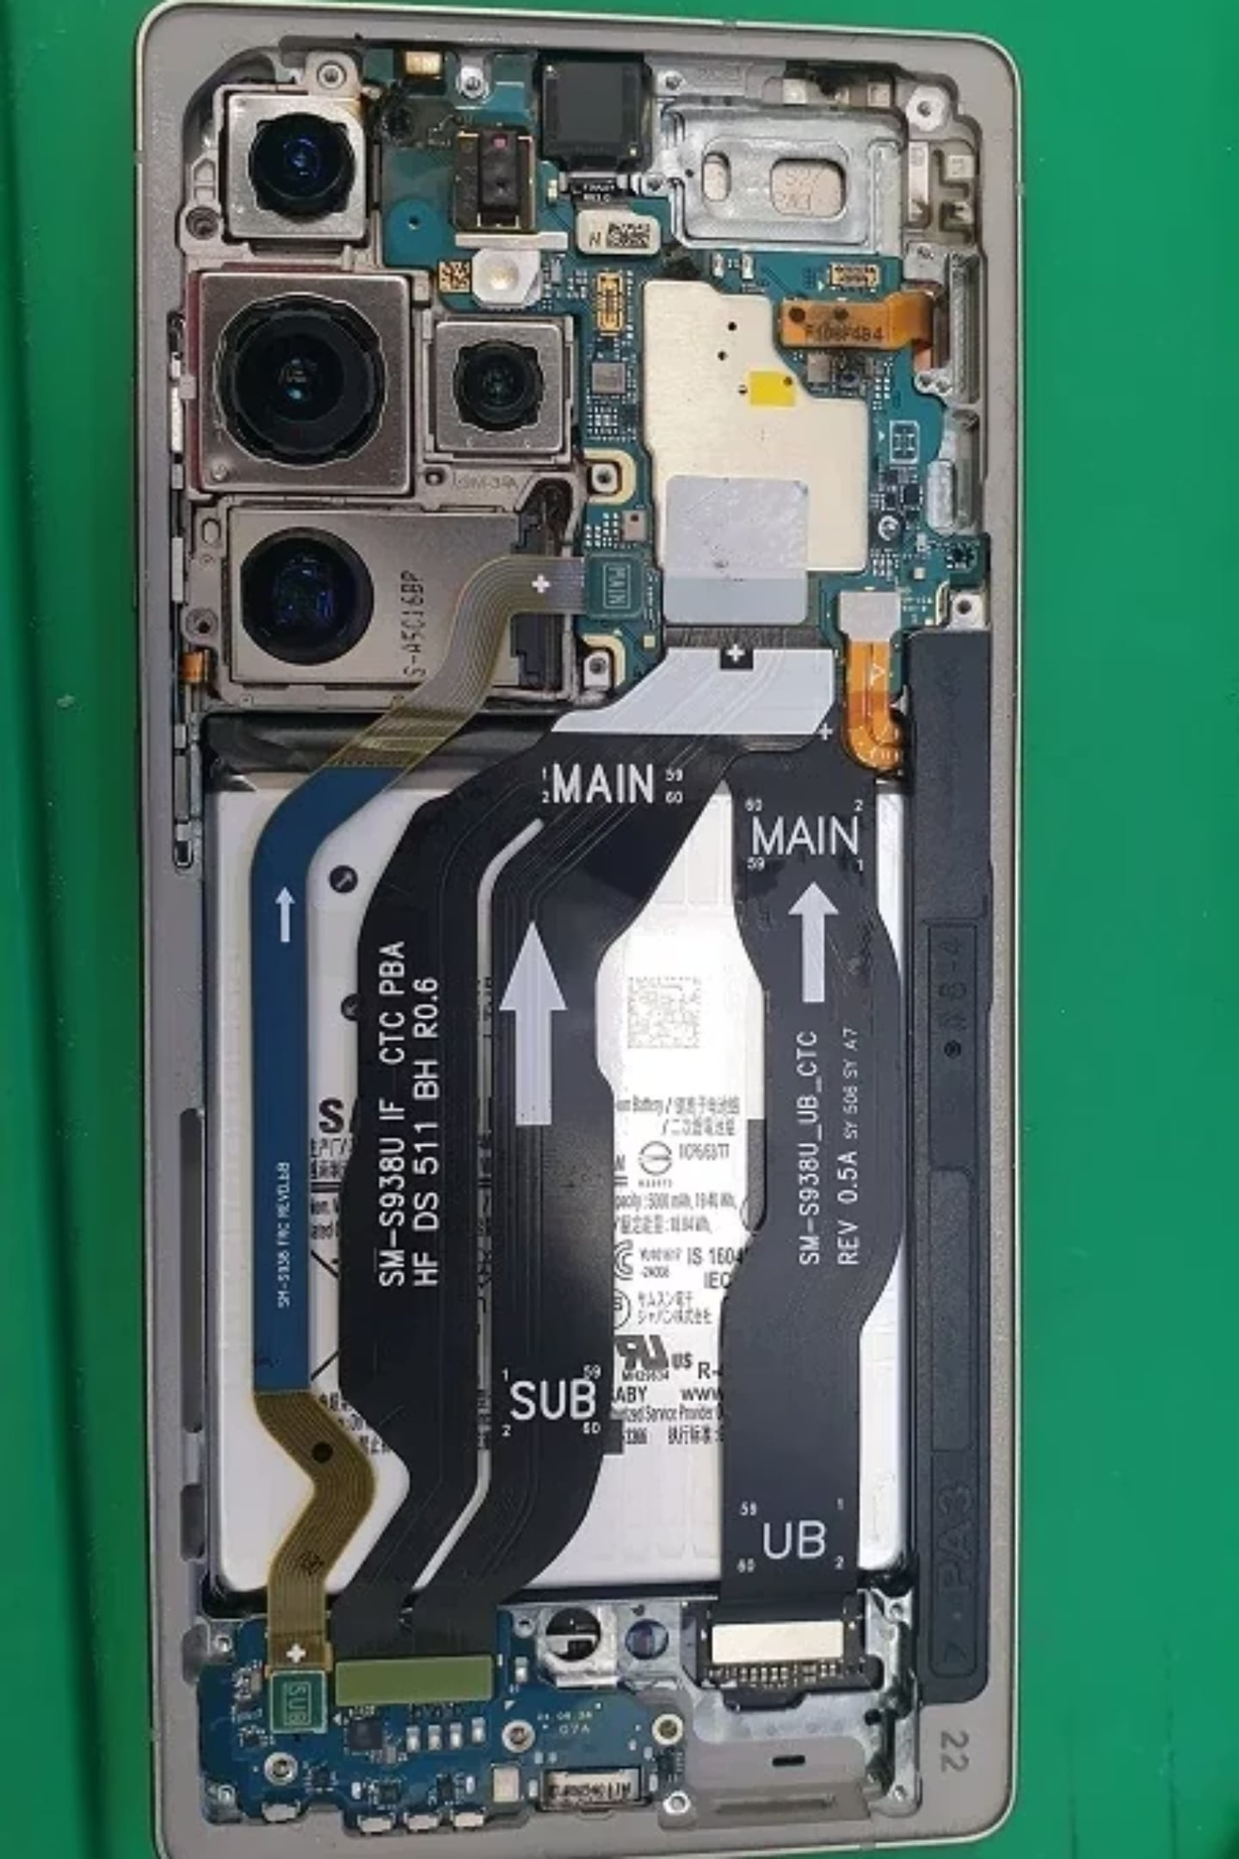
Anatomy of Handheld & Mobile Devices
Core Definition
Ubiquitous Connectivity Framework
A computer or digital engine small enough to be sustained, operated, and manipulated completely within the palm of a human hand.
Operates via persistent wireless arrays including Wi-Fi, Bluetooth protocols, high-speed cellular bands (3G to contemporary architectures), and Near-Field Communication (NFC) for short-range transactions.
Essential Hardware Paradigm
Display Systems: High-definition flat-screen visual interfaces powered strictly by modern Liquid Crystal Display (LCD) or Organic Light-Emitting Diode (OLED) frameworks.
Input Interfaces: Dual-modality interaction design—combining high-fidelity tactile/digital touchscreens with specialized physical keypads, or integrated virtual alphanumeric matrices.

Slide 5

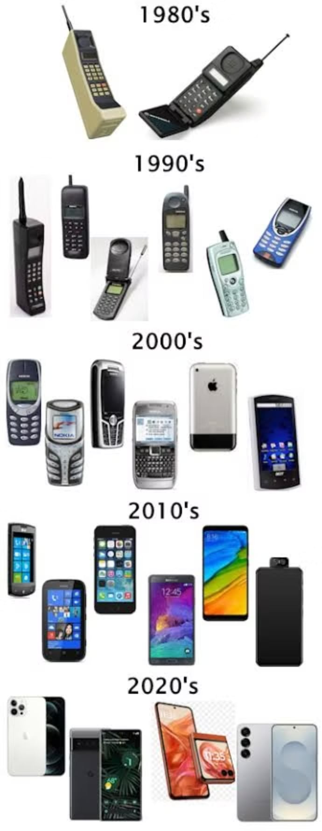
Historical Timeline: The Mobility Curve (1985–2009+)
1
1985–1995: The Genesis of Portability
Early tactical voice transceivers; heavy emphasis on physical component size reduction and basic battery life engineering.
2
2000: The Convergence Threshold
Arrival of early digital networks, dual-band radios, integrated low-resolution CMOS cameras, mobile internet precursors (WAP), and basic color screens.
3
2005: High-Speed Infrastructure Expansion
Proliferation of GPRS/3G networks, high-resolution displays, dedicated MP3 playback engines, and external memory stick integration.
4
2009 & Beyond: The Modern Smartphone Matrix
Full capacitive touchscreens, ubiquitous WLAN/Bluetooth stacks, digital video capture, standalone GPS navigation arrays, and advanced Personal Digital Assistants (PDAs).

Slide 6
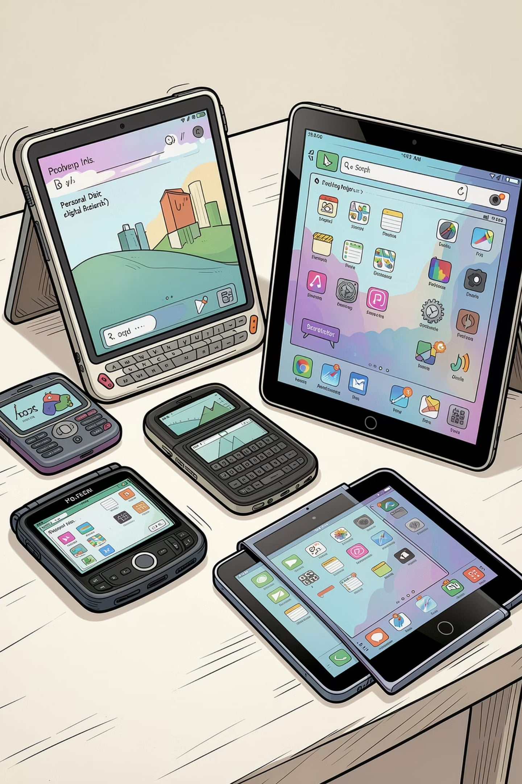
Taxonomy of Handheld Form Factors (Part 1)
Personal Digital Assistants (PDAs)
Tablets & Slates
Context: A wireless, fully portable personal computer featuring an expansive touch-screen interface.
Form Factor Sweet Spot: Fits a distinct operational niche—larger than a standard smartphone, yet significantly more compact and agile than a notebook or laptop computer.
Context: Originally engineered as standalone handheld personal information managers (calendars, address books, note systems).
The Shift: They have been universally displaced by the rapid widespread adoption of highly capable, software-extensible smartphones based on Android and iOS platforms.

Slide 7
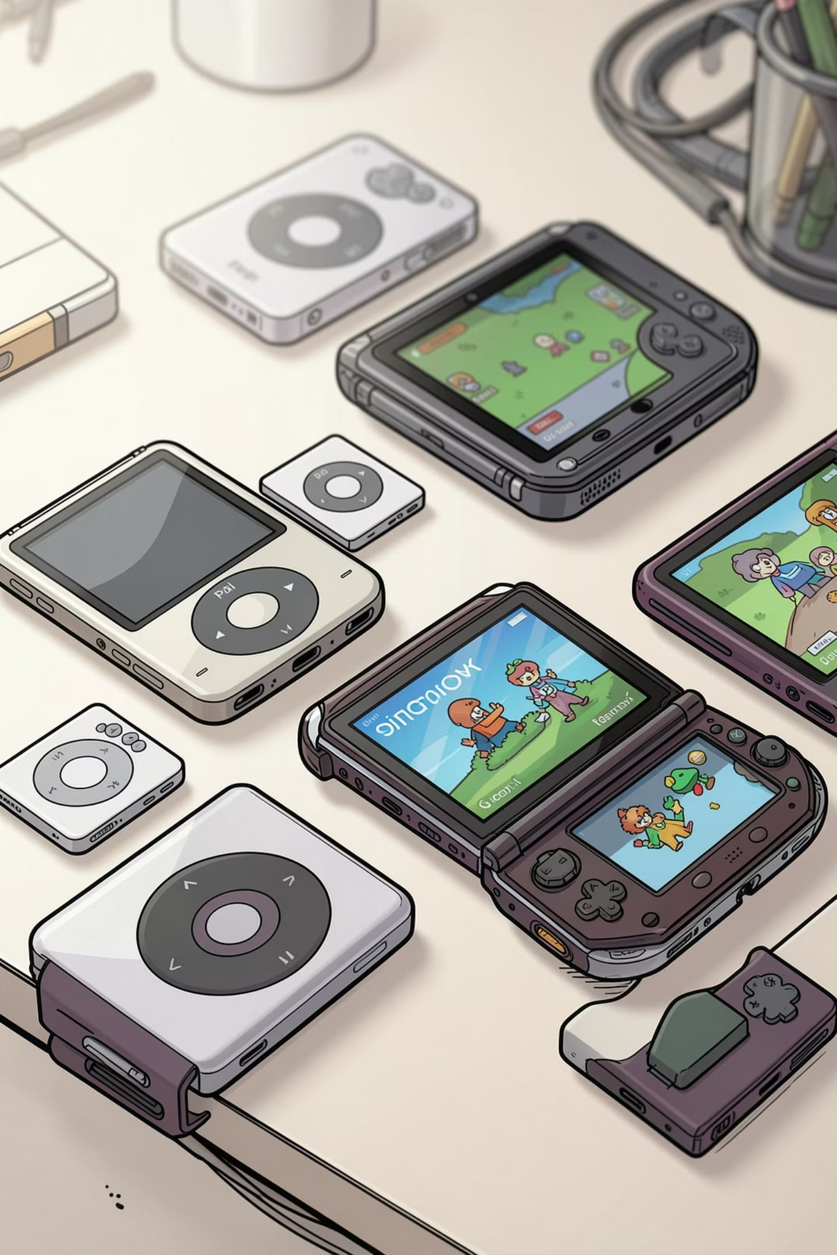
Taxonomy of Handheld Form Factors (Part 2)
Portable Media Players (PMPs)
Auxiliary Legacy & Niche Handhelds
Context: Consumer electronic devices specifically optimized for storing, managing, and seamlessly executing digital media payloads.
Supported Formats: High-fidelity audio streams, high-definition images, and compressed video files.
Voice & Video Communication: Pagers, legacy feature phones, and dedicated satellite communication links.
Entertainment & Utilities: Portable handheld game consoles, dedicated standalone GPS tracking systems, and specialized fax/data terminals.

Slide 8
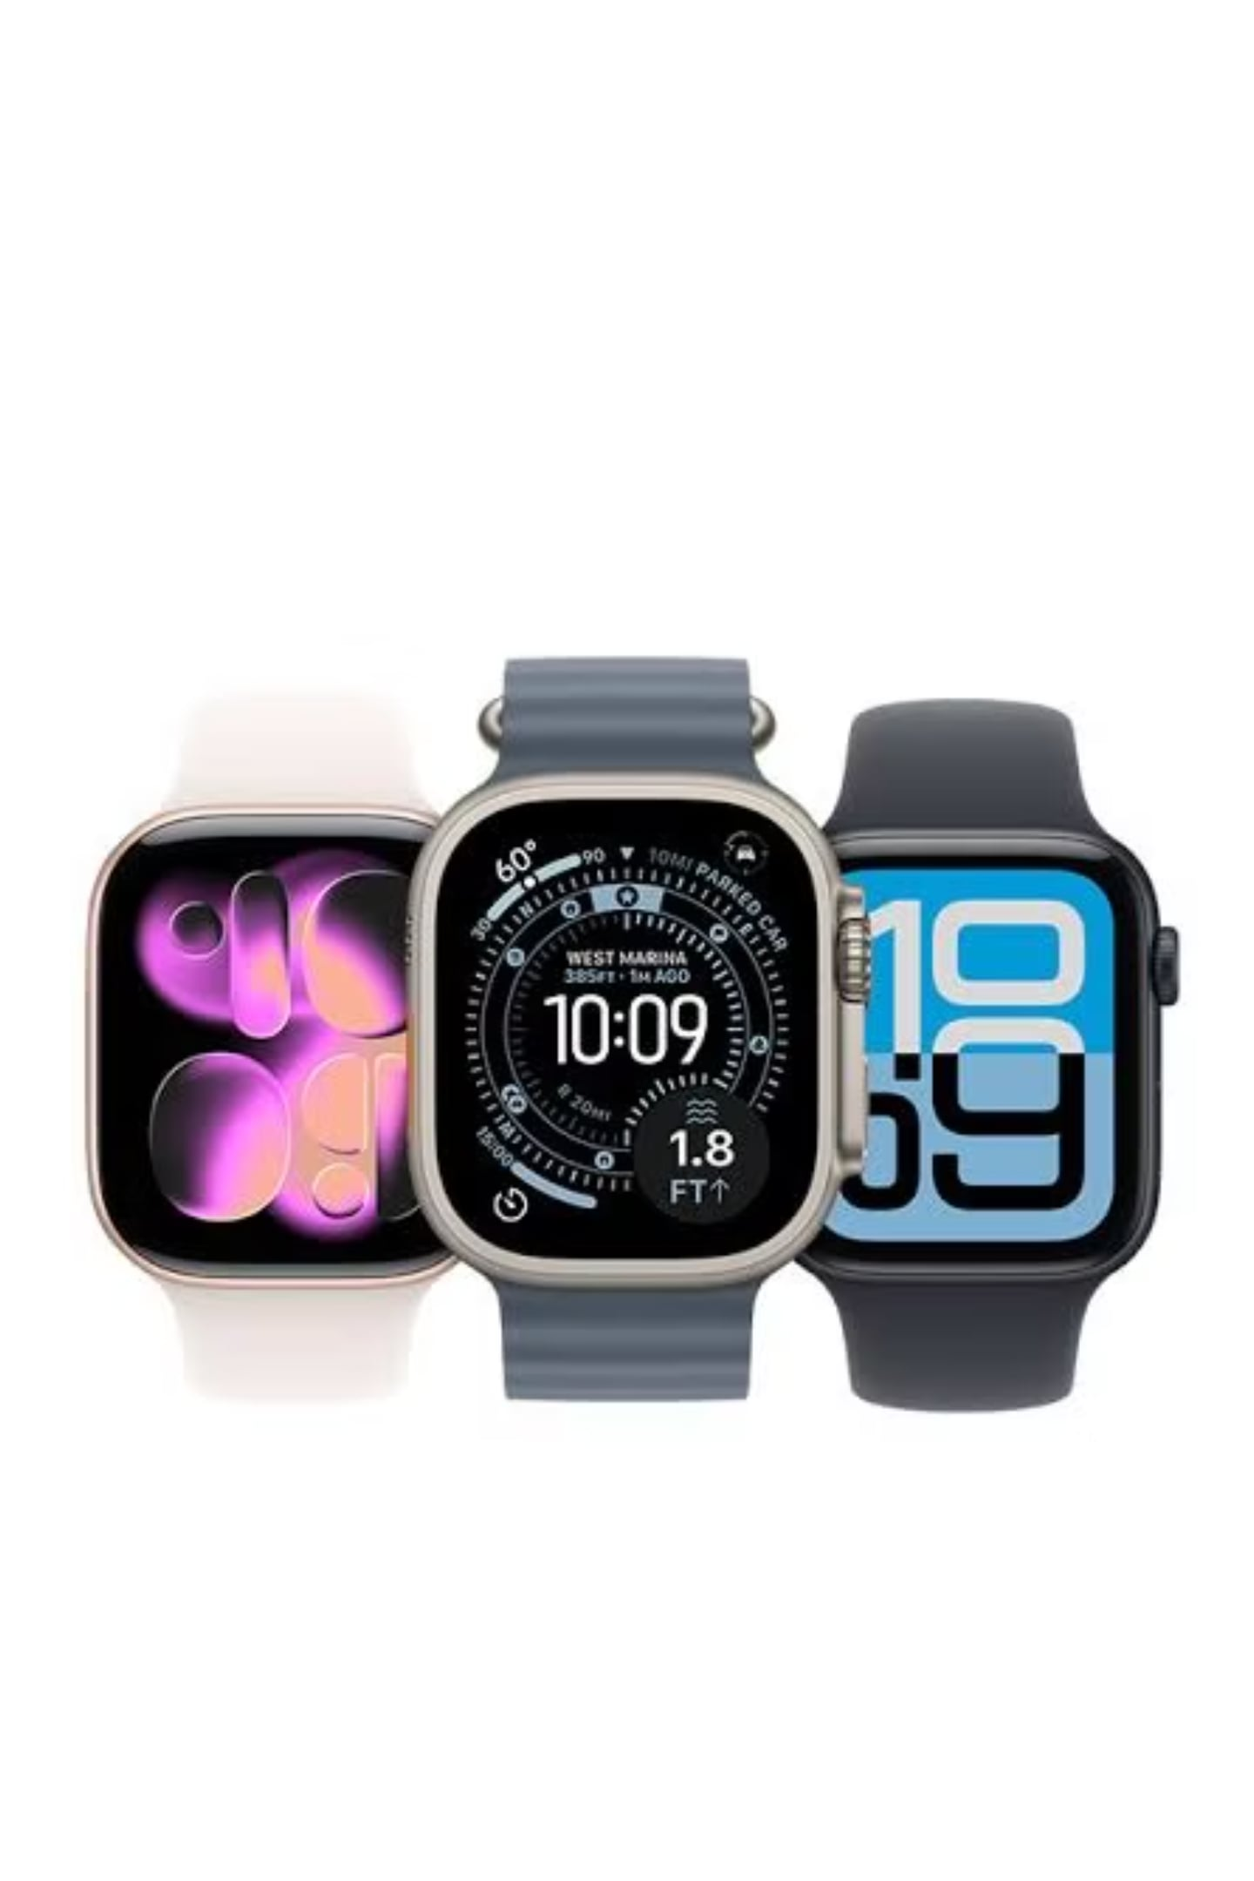
The Proliferation of Wearable Systems
Core Technological Definition
Products tightly controlled by integrated electronic components and embedded micro-software engines that are natively incorporated into clothing or worn directly on the human body as life accessories.
Ubiquitous Ecosystem Integration
Wearables act as highly contextual physical edge nodes. They capture environmental and physiological telemetry data locally, which is then broadcast wirelessly to parent apps on smartphones for cloud processing, storage, and analytics.
Primary Archetypes
Smart Glasses
Smartwatches
Next-Generation Biosensors

Slide 9
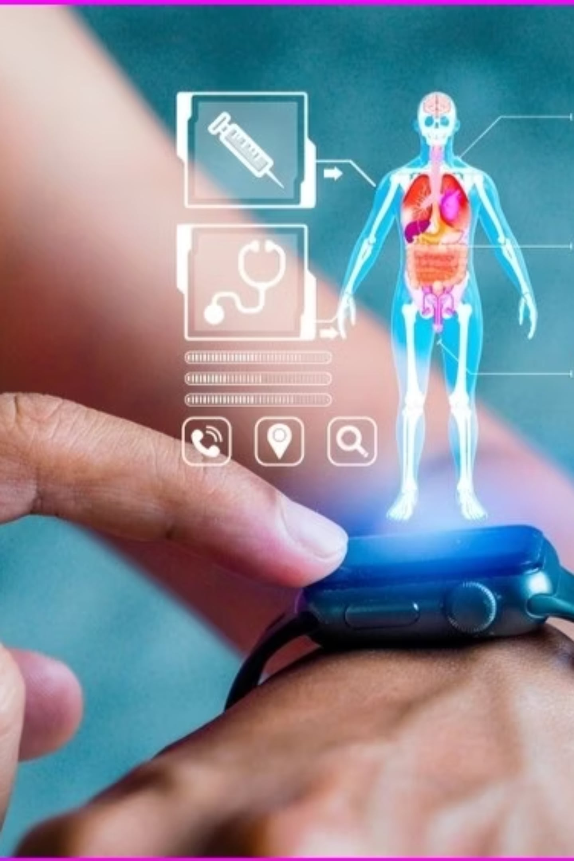


Wearable Classifications: Jewelry, Sensors, & Trackers
1
Smart Jewelry & Ornaments
Includes smart rings, bracelets, watches, and interactive pins. These miniaturized systems look like traditional luxury items but contain micro-displays and contextual vibration components.
2
Body-Mounted Biosensors
Specialized medical-grade sensors placed directly on human skin. Their goal is to persistently monitor, process, and transmit biological data to healthcare databases.
3
Fitness Trackers
Wearables integrated into everyday wristbands, straps, or active headbands. They track physical movement metrics, monitor vital signs, and sync seamlessly with smartphones.

Slide 10
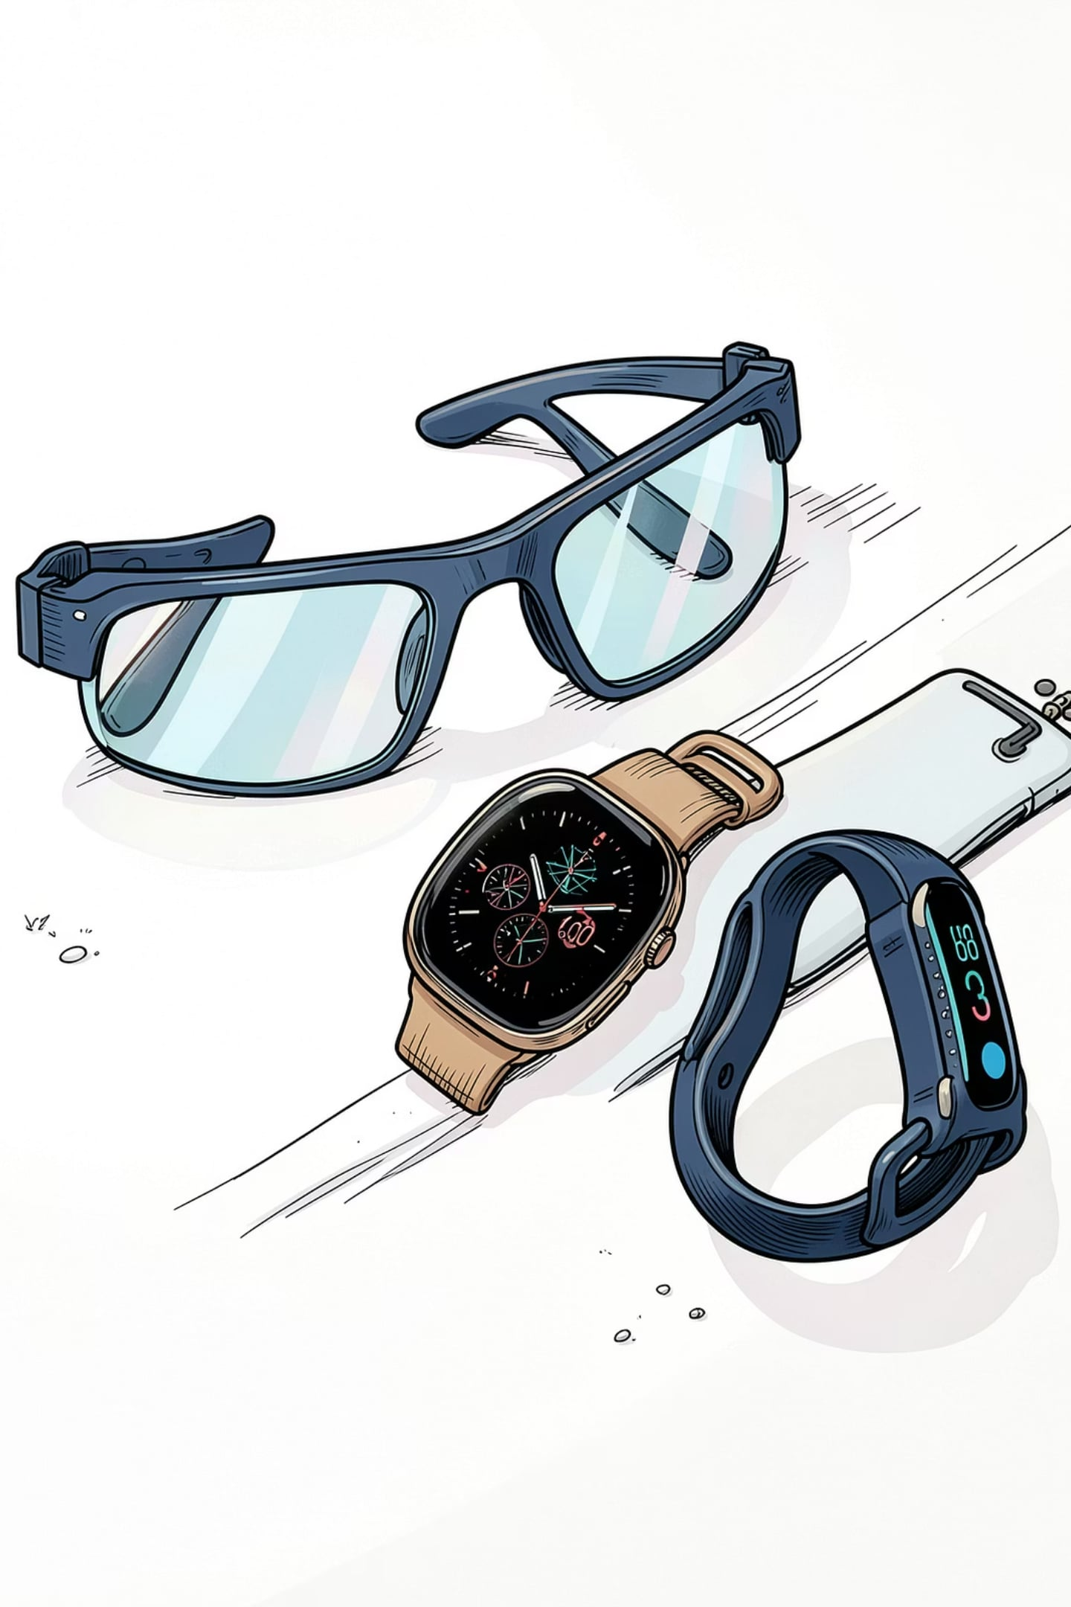

Wearable Classifications: Glasses, Watches, & Head-Mounted Displays
Smart Glasses
1
Optical head-mounted displays (OHMDs) that project digital information directly into the user's field of vision. They often integrate voice commands and gesture recognition for hands-free operation.
Smartwatches
2
Wrist-worn computers that extend smartphone functionality. They handle notifications, health monitoring, GPS tracking, and contactless payments.
Head-Mounted Displays (HMDs)
3
Advanced immersive devices used for Augmented Reality (AR) and Virtual Reality (VR) experiences. They overlay digital content onto the physical world or create fully simulated environments.

